Slide 1
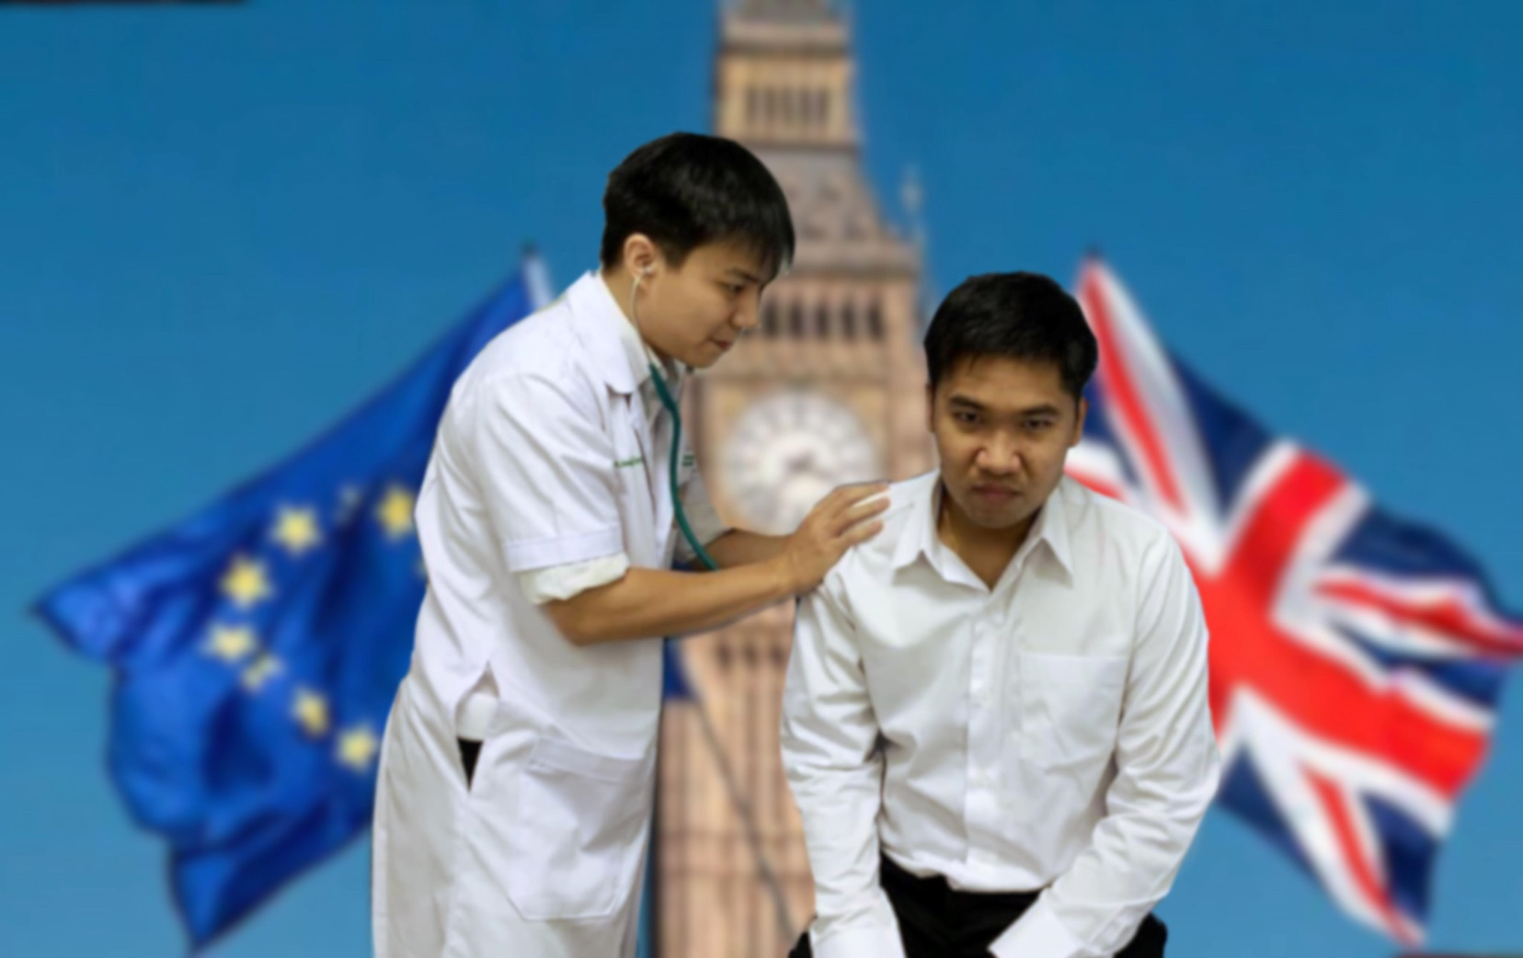
Basic English conversation for communication in medical practice with the foreign patients

Slide 2
บทสนทนาภาษาอังกฤษเบื้องต้นที่ใช้สื่อสารในการตรวจรักษาผู้ป่วยชาวต่างประเทศ
Basic English conversation for communication in medical practice with the foreign patients
จัดทำโดย
นสพ. เจตณัฐ ลิขิตกิจการกุล
นสพ. ชาคร ธีระรุ่งพรกุล
อาจารย์ที่ปรึกษา
ผศ.นพ.ดร.ณตพล ศุภณัฐเศรษฐกุล
ผลงานนี้เป็นส่วนหนึ่งของการเรียนรายวิชา 499702
ภาษาต่างประเทศเพื่อการสื่อสารทางการแพทย์ ปีการศึกษา 2562

Slide 3
คำนำ
ในปี พ.ศ. 2558 ประเทศไทยได้เข้าสู่สมาคมประชาชาติแห่งเอเชียตะวันออกเฉียงใต้ (Association of Southeast Asian Nations หรือ ASEAN) ภาษาอังกฤษจึงมีบทบาทสำคัญเพิ่มขึ้นในการใช้ชีวิตประจำวัน จึงปฏิเสธไม่ได้เลยว่าภาษาอังกฤษนั้นมีความสำคัญมากขึ้นในปัจจุบัน
จากข้อมูลข้างต้นทางคณะผู้จัดทำจึงได้เห็นความสำคัญของภาษาอังกฤษจึงประสงค์ที่จะจัดทำ”บทสนทนาภาษาอังกฤษเบื้องต้นที่ใช้สื่อสารในการตรวจรักษาผู้ป่วยชาวต่างประเทศ” ซึ่งผลงานประกอบไปด้วยตัวอย่างบทสนทนาระหว่างแพทย์กับผู้ป่วยพร้อมเสียงประกอบในสถานการณ์ต่างๆซึ่งประกอบด้วย การซักประวัติ การตรวจร่างกาย การบอกข่าวร้ายและการให้การรักษา ขึ้นเป็นวิทยาทานแก่บุคลากรทางการแพทย์และผู้ที่สนใจโดยทั่วไป

Slide 4
คำนำ
โดยทางคณะผู้จัดทำคาดว่าผลงานชิ้นนี้จะเป็นประโยชน์ต่อบุคลากรทางการแพทย์ในการนำภาษาอังกฤษไปใช้ในการสื่อสารทางการแพทย์และเสริมสร้างความมั่นใจในการสื่อสารภาษาอังกฤษในทางการแพทย์ไม่มากก็น้อย หากมีข้อผิดพลาดประการใดทางคณะผู้จัดทำจึงขออภัย ณ ที่นี้
10/10/2019

Slide 5
สารบัญ
หน้า
Scenario 1 History Taking 4
Scenario 2 Physical Examination 15
Scenario 3 Breaking Bad News 21
Scenario 4 Plan for Treatment and Advice 28

Slide 6
Scenario 1 History Taking

Slide 7
Doctor : Good morning. Please come in and have a seat.
Patient : Good morning, doctor. Thank you.
Doctor : My name is Chakorn Theerarungphornkul.
I am the $5^{th}$ year medical student working with Dr. Natapol. You are Mr. Jettanut Likitkijakarnkul.
Am I pronouncing it correctly?
Patient : Yes, that’s correct.
Doctor : Dr. Natapol is not available right now. He asked me to begin taking care of your medical conditions, and he will be back here as soon as possible. Do you mind if I take some notes as we talk?
Patient : No, I don’t mind. That’s ok.

Slide 8
Doctor : What brings you here today?
Patient : I have a stomach pain.
Doctor : When did it start?
Patient : It started yesterday at about 10.00 p.m.
Doctor : Where exactly that you feel the pain?
Patient : At beginning, the pain was generalized. But, now I can feel the pain right here.
(point to the right lower quadrant)
Doctor : Does the pain radiate to anywhere else, such as going through your back or going down to the groin?
Patient : No. It’s doesn’t.

Slide 9
Doctor : What kind of pain do you have? Is it sharp, dull,
burning, or cramping pain?
Patient : Dull pain.
Doctor : On a scale of 1 to 10, with 10 being the worst pain of your life , how would you rate the pain since last night?
Patient : Last night, I would say 2. But right now, I would say 7.
Doctor : Were you doing anything when the pain started last night?
Patient : Yes. The pain started when I was just reading the tourism review on the mobile phone lying down in bed.

Slide 10
Doctor : Throughout the night, did you have to wake up because of the pain?
Patient : No, I slept throughout the night.
Doctor : Do you feel nauseated?
Patient : Yes, this morning, I feel sick to my stomach.
Doctor : How is your appetite?
Patient : I feel not hungry right now.
Doctor : Did you have a fever last night?
Patient : Yes, I think so. But, I didn’t measure the temperature exactly.
Doctor : Did you have night sweats last night?
Patient : No, apparently not.

Slide 11
Doctor : Do you have any diarrhea?
Patient : No.
Doctor : Is there any period of time that you were constipated last week?
Patient : No.
Doctor : Have you recently noticed any blood in your stool?
Patient : No.
Doctor : Do you have any problems with bladder in terms of burning to urinate?
Patient : No.

Slide 12
Doctor : Have you noticed any blood in your urine?
Patient : No.
Doctor : Ok. Now, I would like to ask about your past medical history. Do you have any allergies?
Patient : No.
Doctor : Do you have any other medical problems or
underlying diseases?
Patient : No.
Doctor : Have you had any surgeries before?
Patient : No.

Slide 13
Doctor : Have you been hospitalized before?
Patient : No.
Doctor : Alright. Let’s move on to the family history.
Is there any history of blood clot problems running in your family?
Patient : No, there is not.
Doctor : Does anyone in your family have the same problem or anything similar?
Patient : No.

Slide 14
Doctor : In the next couple of questions, I need to ask you some questions that are more personal, and I assure you that everything will be kept confidential. would it be ok for you?
Patient : Ok.
Doctor : Are you sexually active?
Patient : No.
Doctor : Have you ever had a sexually transmitted disease?
Patient : No, I’ve never had sex. I’m still virgin.

Slide 15
Doctor : Do you smoke?
Patient : No.
Doctor : Do you drink alcohol?
Patient : No.
Doctor : Good. Do you have any other problems that we haven’t talked about?
Patient : No.

Slide 16
Doctor : Thank you very much for the interview.
To summarize, your problem is mainly an abdominal pain located in the right lower part of your stomach. It’s a dull pain and it doesn’t radiate to anywhere else. Next, I will proceed to the physical examination. Is that alright with you?
Patient : Ok, that’s alright.

Slide 17
Scenario 2 Physical Examination

Slide 18
Doctor : Mr. Jettanut, from history taking, your symptoms look similar to one who has an appendicitis. However, I really need to examine your abdomen to find out what’s causing the problem. Are you ok with that?
Patient : Ok.
Doctor : First, I’m going to examine your abdomen while
you’re lying down on your back. Then, I will listen to your stomach with a stethoscope.
Also, I have to palpate and deeply press around that area. It might hurt a little bit. If at any time you feel uncomfortable, you can let me know, ok?
Patient : Ok.

Slide 19
Doctor : Alright, please lie down on your back on the examining bed. I’m going to wash my hands and close the curtain before beginning the examination.
Doctor : First of all, I’m going to roll up your gown a little bit to expose the stomach area. I will take a look at your abdomen to check for the bruise, scar, and distention.
Patient : Ok.
Doctor : Good. It looks like normal. Now, I will listen to your stomach with the stethoscope for bowel movement. Just breathe in and out normally, ok?
Patient : Ok.

Slide 20
Doctor : Good. Now I need to tap on your belly in order to check if the liver and spleen are normal size.
Ok. Now, I’m going to press deeply on your abdomen. If it hurts, please let me know, ok?
Patient : OH! It really hurts, doctor.
Doctor : Now, I’m going to press on your abdomen and abruptly let go. Please let me know which one hurts your more, when I press or when I let go?
Patient : Ok. OH! It really hurts when you let go, doctor.
Doctor : Next, I’m going to bend your right knee, flex and rotate your knee, ok?
Patient : OH! It’s really hurt, doctor.

Slide 21
Doctor : I’ll do it just one more time, ok?
Patient : OH! It’s really hurt, doctor.
Doctor : Ok, that’s it. Now, I’m going to tap on to your back. Does it hurt at all?
Patient : No, not really.
Doctor : Ok. That’s finished now. All done. Thank you for
your cooperation. You can sit up now if you’d like.
Patient : Huh…h

Slide 22
Doctor : According to the history taking and physical examination, it looks very much like that you’ve got what we call an “appendicitis” which means an inflammation of your appendix. However, we need to do some laboratory tests
by drawing your blood sample to confirm the diagnosis. In the meantime, you have to stop eating and drinking anything in order to prepare for the operation. Is that ok with you?
Patient : Ok. Thank you, doctor.

Slide 23
Scenario 3 Giving Bad News

Slide 24
Doctor : Good morning, Mr. Chakorn. I’m glad to see you again. Thank you for your coming.
Patient : Good morning, doctor. I’m glad to see you too.
Doctor : Today, I will review the pathology results of your tissue biopsy that we sent it last week.
Patient : Ok.
Doctor : Is there anyone coming to hear the result with you today?
Patient : No, I came to hear it alone.
Doctor : First, let me switch off my mobile phone and recheck the door to see if it’s closed already. So, it wouldn’t be any interruptions during our talk.

Slide 25
Doctor : Do you know why I had to do the kidney biopsy last time we met?
Patient : Yes, I do. I think because you found something suspicious in my CT scan results. And, you were not sure if it might be a malignant tumor.
Doctor : Yes, that’s right. Today, I have a lot of information received from the pathology results. But first, I would like to know how much in detail of the information that you really want to know.
Patient : Umm…Let me know everything that you have. I’m going to be just fine.

Slide 26
Doctor : Alright. Unfortunately, I think it’s not quite a good news. From the pathology results, the kidney biopsy reveals some kinds of renal cancer which is considered somewhat aggressive.
Patient : Cancer? Really? Do you have any idea? How bad is it?
Doctor : The result confirms it is definitely a cancer. However, we have found it early, it’s just only stage l cancer. That means the cancer has not spread to other organs yet.
Patient : ….

Slide 27
Doctor : I know this is unexpected bad news. I’m really sorry to tell this news. Can you tell me how you feel right now?
Patient : I feel overwhelm.
Doctor : I know this must be very hard for you. I can understand why you feel like that. Everyone would react the same way.
Patient : Are there any treatment plans for this?
Doctor : Would you like me to tell you about some of the treatment options that we have?
Patient : Yes, please.

Slide 28
Doctor : First, we have chemotherapy and also radiation. But, it is not so effective. Another option is surgical treatment which is more effective and curable.
Doctor : However, you don’t have to make the decision right now. You can have time to consider and talk about this with your family. Also, you can come back to see me at anytime whenever you are ready to set up the treatment plan. Please be assured that we will definitely pass through this situation together, ok?
Patient : Ok. Thank you, doctor. I can’t think of anything at this moment. I’ll contact you again later when I’m ready.

Slide 29
Doctor : Sure, you can. Please take care. Goodbye.
Patient : Goodbye.

Slide 30
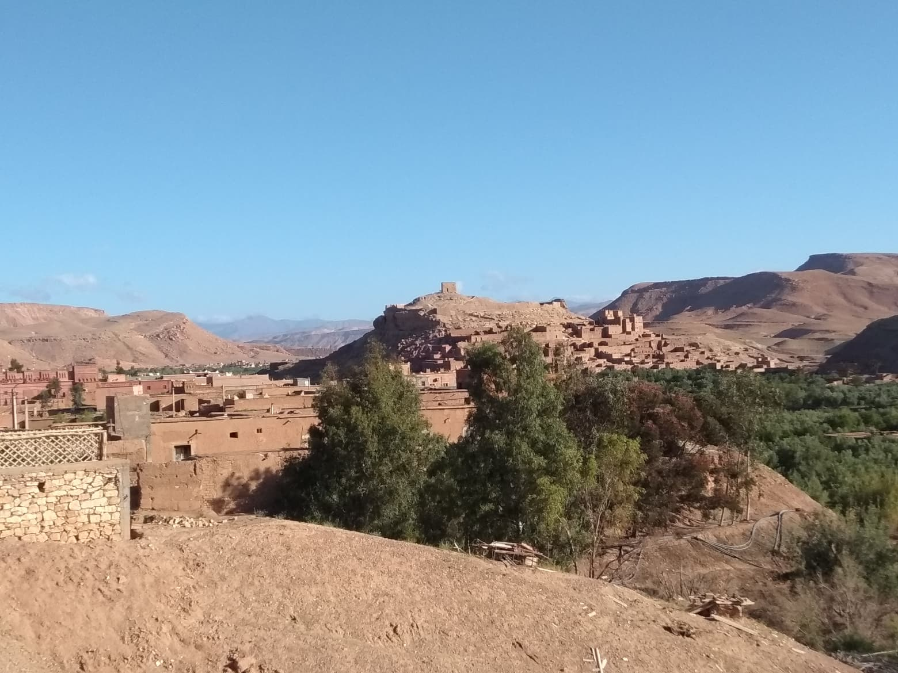
Scenario 4 Plan for Treatment and Advice

Slide 31
Doctor : Mr. Chakorn, let’s move on to set up a treatment plan for your medical conditions, ok?
Patient : Ok.
Doctor : First of all, I need to clean your wound perfectly. And then, I will give you a shot of rabies prophylaxis vaccine. There are 2 ways you can choose to receive the vaccination. The first one, we need to inject one shot of vaccine into the muscle on the 1st,3rd,7th,14th and 28th day, totally 5 shots from today. The other one is to apply two shots of vaccine beneath your skin on the 1st,3rd,7th and 28th day, totally 4 times. Do you understand what I’ve just said?
Patient : Yes. But, what are the differences between these two?

Slide 32
Doctor : Actually, they are both the same in terms of preventing the disease effectively. But, the differences are the injection techniques and the number of times visiting to the hospital.
Patient : Ok, I see.
Doctor : Have you made your decision yet?
Patient : I think the second one is suitable for me.
Doctor : Ok, sure. By the way, your wound needs to be cleaned every day. You can come here or visit a nearby clinic for wound dressing. Please avoid contact your wound with water and all dirty stuffs. Would it be ok?
Patient : Ok.

Slide 33
Doctor : I will also give you some antibiotic drugs. Take 1 capsule twice daily, in the morning and in the evening, continually for 5 days. Is that ok with you?
Patient : Yes, sure.
Doctor : To summarize, you have to clean your wound every day, take a shot of vaccine as scheduled, and take the antibiotics regularly until completed. Are there any other questions that you might have?
Patient : No.

Slide 34
Doctor : Very well. Then, I’ll see you again in the next 3 days. In the meantime, If your condition is getting worse, such as you have more pain, or any other symptoms suddenly happen. Please contact me right away and come back to the hospital, ok?
Patient : Ok. Thank you very much.
Doctor : You’re welcome. Get well soon and see you then.
Patient : Goodbye, doctor.

Slide 35
เอกสารอ้างอิง
McCullagh M. and Wright R., “Good Practice Communication Skills in the English for the Medical Practitioner”, Cambridge university Press,2008.
Glendinning E.H. and Holmström B.A.S., “English in Medicine, Third edition”, Cambridge: Cambridge university Press,2005.
นพดล สโรบล. “What’s up Doc”, กรุงเทพมหานคร: ลลิต คอนซัลทิ่ง เฟิร์ม, 2543.
Digital image retrieved from https://safety4sea.com/shipping-companies-exit-british-flag-as-brexit-approaches/

Slide 36
เอกสารอ้างอิง
อัจฉริยะ แพงมา.คู่มือการซักประวัติผู้ป่วยต่างชาติ.[อินเทอร์เน็ต].สืบค้นเมื่อ 12 มิถุนายน 2562, เข้าถึงได้จากhttp://www.niems.go.th/th/View/DataService.aspx?CateId=117
วาทิต จั่นแย้ม.คู่มือสนทนาภาษาแพทย์ การคัดกรองผู้ป่วยและสนทนา ภาษาอังกฤษ ไทย จีน แบบสบายสบาย.[อินเทอร์เน็ต].สืบค้นเมื่อ 11 มิถุนายน 2562, เข้าถึงได้จาก http://www.drwathits.com/images/sampledata/DataOnweb/pagefront/2.pdf?fbclid=IwAR1YVGfE2NBp9_f7WSVL8xLju5UZTHlNXtIDhs1Oi4Xx3cYVJr4muwXIxc4

